Slide 1
Introduction of Real-World Signals and Systems into ECpE DSP Laboratory Curriculum
Members:
Brady A. Max K.
Sam B. Emily L.
Mitchell H. Isaac R.
Advisor: Matthew Post
Client: Matthew Post Website: http://sddec20-14.sd.ece.iastate.edu/
Notes:
Ren

Slide 2
Problem Statement
Conceptualizing the signals and systems curriculum at Iowa State University can be frustrating for new students.
The CyDAQ team seeks to redesign the signal processing laboratory curriculum using the CyDAQ teaching platform to help alleviate this frustration.

Slide 3
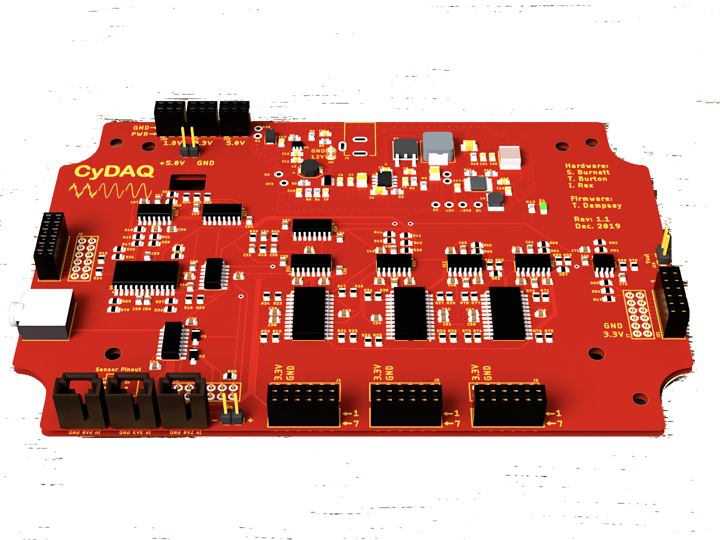
Introduction to CyDAQ
CyDAQ is a hardware teaching platform designed for EE 224/324 that contains onboard analog filters and interfaces for sampling data to a PC.
Our goal is to design labs and supplemental hardware that connect core concepts to real world hardware.
Figure 1: CyDAQ Board
Notes:
Brady

Slide 4
Conceptual Sketch
CyDAQ
Software/Firmware
Hardware
Labs
Embedded
Signal Routing
Real-World Application
Graphical Interface
Sampling
EE 224 & 324
FPGA
Band-limiting
Learning Objectives
Notes:
Ren

Slide 5
Hardware Requirements
Functional:
Variable sample rate
Adjustable analog filters
Low noise power delivery
Standard sensor interfaces
Digital to analog converter
Parallel signal handling
Non-Functional:
CyDAQ unit costs ~$350
Durability
Physical
Electrical
Expandable for future use
Well documented example of good hardware design
Notes:
SAM

Slide 6
Software Requirements
Functional:
Configure all analog filters
Concurrent sampling and sample storage
Simple GUI for lab use
Constrained front-end for students
Full-featured back-end for debugging
Non-Functional:
Responsive interface
Impervious to serial data loss
90% code coverage for unit tests
Well documented; example of good software design
Notes:
Brady

Slide 7
Lab Requirements
Functional:
Follow class learning objectives
Use real-world application as lab motivation
Create 4+ labs for EE 224 and EE 324
Non-Functional:
Doable by 1-2 students in 2-4 hours
Made in LaTeX; visually pleasing
Serves as an example for additional ECpE course labs
Notes:
Ren

Slide 8
Additional Constraints & Considerations
COVID-19 Impact
Reduced number of labs created and put into EE 224 Spring 2020 semester
Reduced amount of feedback from students in lab
Modified lab documents to fit online classes
Economic Considerations
Cost to produce, repair, and replace
Environmental impact and power efficiency
Notes:
Max

Slide 9
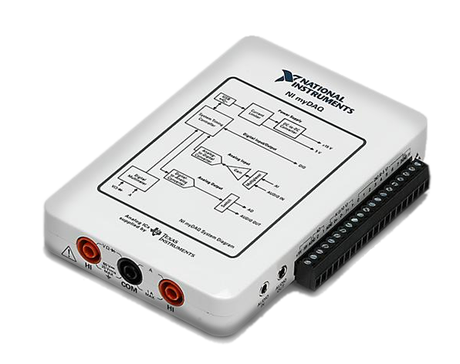
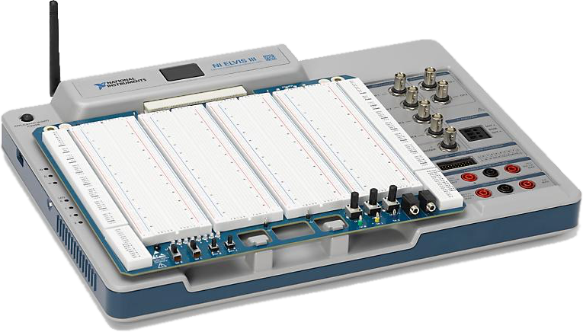
WhyDAQ?
Market Alternatives
National Instruments MyDAQ
Similar feature set, but lacks programmability and expandability
Tied to NI’s suite of software
$371.00
National Instruments Elvis III
Improved expandability, includes FPGA
Tied to NI’s suite of software
$2,897.00
Figure 2: NI MyDAQ
Figure 3: NI Elvis III

Slide 10
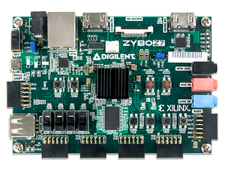
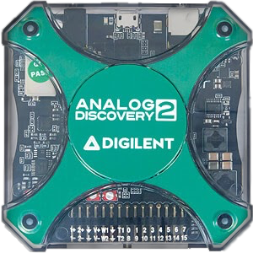
WhyDAQ?
University-developed platform
Designed with the ECpE DSP curriculum in mind
Open source software, written in industry standard Python and MATLAB
Expandable to fill teaching needs of many classes in both lecture and lab
Fully programmable Xilinx FPGA
Compatible with industry standard lab tools, designed for Digilent Analog Discovery multi-function instrument
Total BOM cost of ~$500
Includes Digilent Analog Discovery
Figure 4: Xilinx Zybo Z7
Figure 5: Digilent Analog Discovery 2
Notes:
max

Slide 11
Potential Risks & Mitigation
Risk: Components of the CyDAQ are damaged due to student abuse Mitigation: CyDAQ and FPGA are enclosed in a transparent polycarbonate box
Risk: FPGA is damaged by the addition of incorrectly added hardware components Mitigation: Team members read datasheets and become knowledgeable about components and pinouts before connecting to the FPGA
Risk: Hardware component delays due to COVID-19 Mitigation: Team members order components early and expect delays in shipping
Notes:
Ren

Slide 12
BOM Cost
Part | Cost
PCB Components | $112.29
Enclosure | $22.60
Mounting Hardware | $16.39
Zybo Z7 | $199.00
Digilent Analog Discovery 2 (DAD) | $279.00
Total (without DAD) | $350.28
Total (with DAD) | $629.28

Slide 13
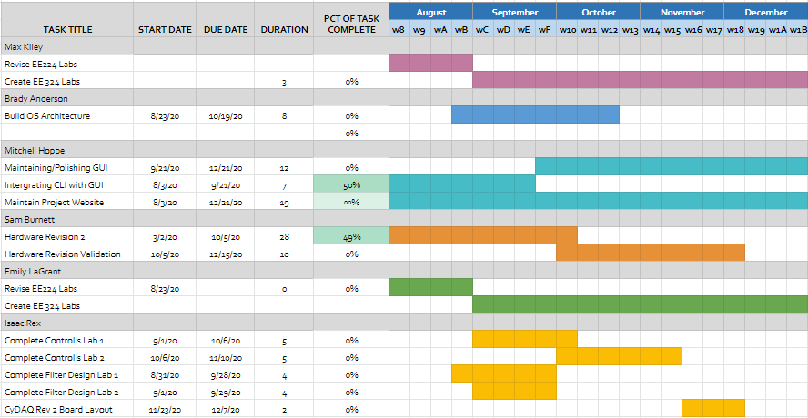
Project Schedule
Notes:
max

Slide 14
CyDAQ Fundamentals
1st Order High Pass
CyDAQ
Zybo
PC
Sample Output
GUI
1st Order Low Pass
2nd Order Band Pass
Python
MATLAB
6th Order High Pass
Signal Input
6th Order Low Pass
6th Order Band Pass
Analog Sensor
Notes:
Mitchell

Slide 15
CyDAQ Fundamentals - CyDAQ Hardware
Analog Signal Flow Control
Input select configurable through I2C controlled multiplexers.
Input level shifting and impedance isolation
Output filtering and impedance isolation
Analog Filter Configuration
Signal band-limiting configurable through I2C controlled solid-state potentiometers
Filter order stacking and corner selection programmable from FPGA platform
Digital Signal Processing
Analog to digital Conversion through FPGA XADC input driver / level shifter
Digital to analog Conversion through SPI fed external DAC integrated circuit
Notes:
SAM

Slide 16
CyDAQ Fundamentals - Zybo Firmware
Single-Core ARM Application
Handles scheduling logic, sampling, and PC software interface
FreeRTOS operating system to allow parallel operations
FPGA Programmable Logic cores
XADC core performs 1MS/s sampling
AXI GPIO cores allow general sensor interfaces
Other custom-made cores added as necessary for labs
Flexible firmware is a key feature of CyDAQ
Notes:
Brady

Slide 17
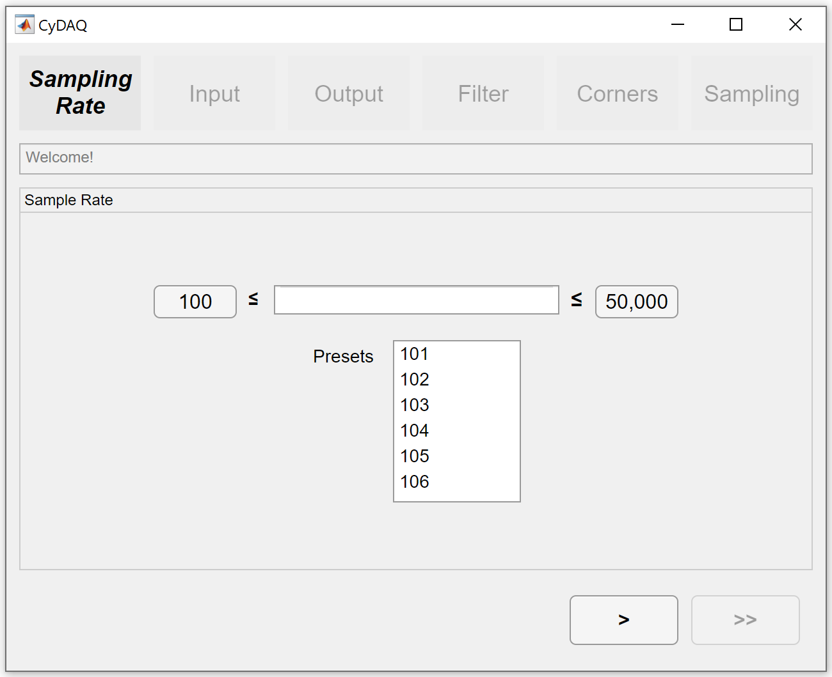
CyDAQ Fundamentals - PC Software
MATLAB Front-end
Handles user interactions through buttons, text boxes, and selectors to configure and sample the board.
Sampled data can be exported to .csv or .mat file
Python Back-end
Verification of the given parameters
Communication to the Zybo FPGA over USB.
Figure 6: GUI Start Page
Notes:
Mitchell

Slide 18
Technology Platforms
Hardware
Low-noise Switch Mode Power Supplies (SMPS PMICs)
I2C configurable solid state potentiometers
I2C configurable signal routing multiplexers
Zybo FPGA development board direct mount
UART Serial PC connectivity
SPI Digital to Analog Conversion capability expansion
Software
Python
MATLAB App Designer
JSON
Notes:
SAM
JSON - for saving/ loading Zybo configurations from the user-side
Python - communication from the PC to the Zybo
MATLAB - GUI design and data manipulation

Slide 19
Test Plan
Software
Unit Testing
Testing each function such that no input yields an unexpected output or error
Code coverage goal should be ~90%
UI Testing
Testing the interaction of the UI components leads to the correct state of the program
Most commonly used UI components should be tested
Chances of catching an error is low, but highly valuable if one is found.
Integration Testing
Build tests such that interaction between components is sound during test runs, but also runtime tests occur incase connection is broken or cannot be established and contingencies must be dispensed.
Notes:
Mitchell

Slide 20
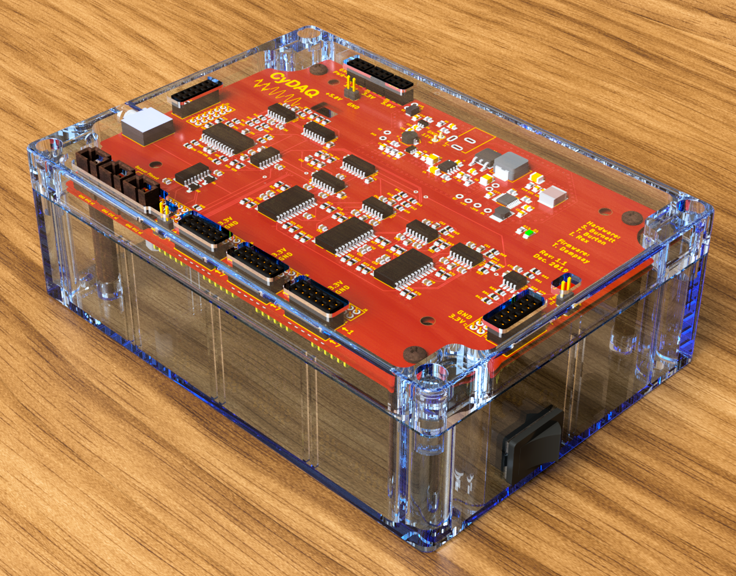
Current Implementation
CyDAQ Designed by ETG
Single-process high-level firmware
Minimal GUI
Fully-featured filter board
Variety of interfacing options for peripheral hardware
Supply of base CyDAQ units fabricated and ready for deployment
No peripheral modules designed
No labs designed around the CyDAQ
Figure 7: CyDAQ in Polycarbonate Case
Notes:
Max

Slide 21
Project Status (with respect to milestones)
Hardware
DAC evaluation module completed and ready for characterization
Parallel XADC passive input level shifter completed, tested, validated
Software
The GUI is being laid out with integration with Python happening concurrently
Labs:
Completion of ¾ labs for 224 and began conceptualizing lab documents for EE 324
Tested one lab with EE 224 students with feedback to be received after semester completion
Notes:
Brady

Slide 22
Member Responsibilities
Brady A.
Embedded Systems - Firmware development and testing
Sam B.
Hardware Expansion Design
Hardware Design Requirements
Lab Development
Mitchell H.
Web Designer
GUI Designer
Max K.
Lab Development
Noise Reduction Lab
Soldering and hardware assembly
Emily L.
Lab Development including:
Noise Reduction Lab
Final Project Labs
Isaac R.
Team Communication Lead
Hardware Design And Implementation
Lab Development
Notes:
Mitchell
BA - programming the firmware and embedded systems on the Zybo
Sam - Hardware lead, responsible for designing the CyDAQ board
Max - Hardware assistant and lab drafter
Emily - Lead lab drafter
Isaac -

Slide 23
Project Timeline
Spring 2019
Fall 2019
Spring 2020
Fall 2020
Requirements Defined, Analog Filters Redesigned
Platform Hardware Redesign
Lab Design,
Software Development
Hardware Expansion,
Lab Implementation
Functional design and validation of filters
State variable filter
Digital control scheme
Design and validation of power delivery
Sensor interfaces
Full I/O definition
Mechanical definition
Curriculum integration
User interface design
Platform firmware
Control flow development
Expanded functional requirements
Final hardware revision
PMOD expansion development
Lab document delivery
Notes:
SAM

Slide 24
Thank you for listening!

